Slide 1
Sales Prediction Project
By Prakash87Dakshina

Slide 2
Overview
The Sales Prediction Project uses past data from multiple retail outlets to predict future sales. Using multiple Python libraries, we have; cleaned, explored, and pre-processed data to prepare the data for machine learning. Using 2 different machine learning models, we were able to fine-tune our ML models to deduct the best implementation method for the project.

Slide 3
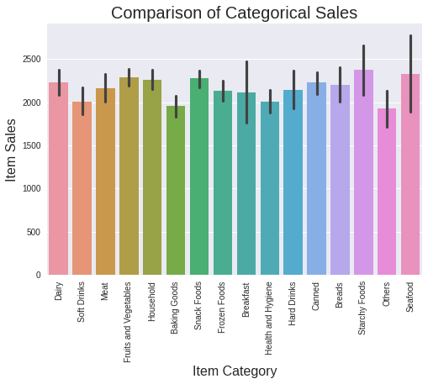
Does the Category affect sales?

Slide 4
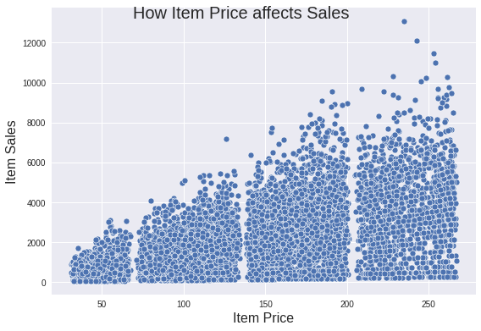
How does the items price affect sales?

Slide 5
How did our learning models perform?
Linear Regression
Decision Tree Regression
Fine-tuned decision tree regression

Slide 6
Recommendations moving forward
Use the best tuned models
If time and resources permit test other models
Understand how the model effects implementation

